Slide 1
Ge 116: introduction
This is a class in analytical methods, but what does that mean?
  Operating the instruments, obviously, but more importantly…
  Understanding the physical basis of each kind of measurement and
  Understanding the fundamental statistical nature of measurement, the nature of uncertainty, the difference between accuracy and precision, and systematic vs. random errors.

Slide 2
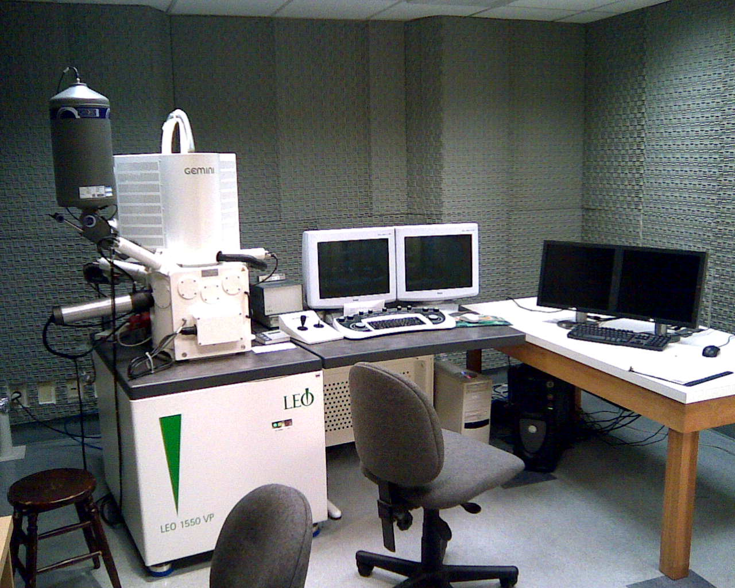
Ge 116 Module 1: Scanning Electron Microscopy
Part 1: Electron optics, beam-specimen interactions & imaging

Slide 3
What is an SEM?
It is not a TEM (transmission electron microscope)
  TEM is the electron-optics equivalent of a transmission optical microscope, taking advantage of the tiny deBroglie wavelength of electrons to achieve ultra-high spatial resolution, with tiny field of view and need for ultra-thin sample foils
It is not a STEM (scanning tunneling electron microscope) or AFM (atomic force microscope)
  These instruments put a probe extremely close to a sample and move the sample the build up a raster image, depending on near-field interactions to determine sample properties at atomic resolution

Slide 4
What is an SEM?
Rather, it is a Scanning Electron Microscope
  A well-focused beam of electrons is scanned in a raster (or boustrophodon) pattern over an area on the surface of a stationary sample
  Signals generated by beam-specimen interactions are measured as a function of time during the scan and mapped to spatial position on the sample
  Images are built up by plotting signal intensity vs. position — like a conventional cathode-ray tube television. Noise is reduced by scanning slowly or by integrating over many scans
  The scan can be stopped to focus temporarily on a point of interest

Slide 5
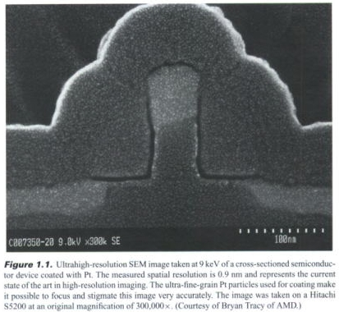
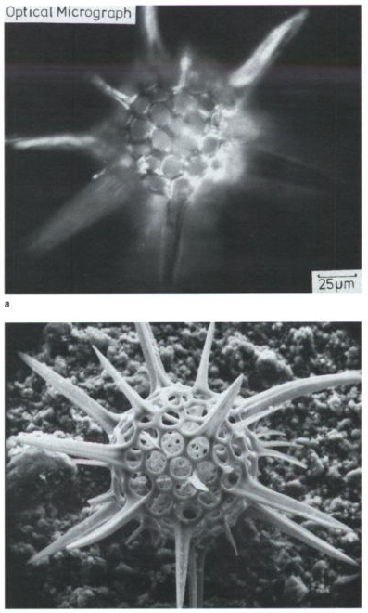

Slide 6
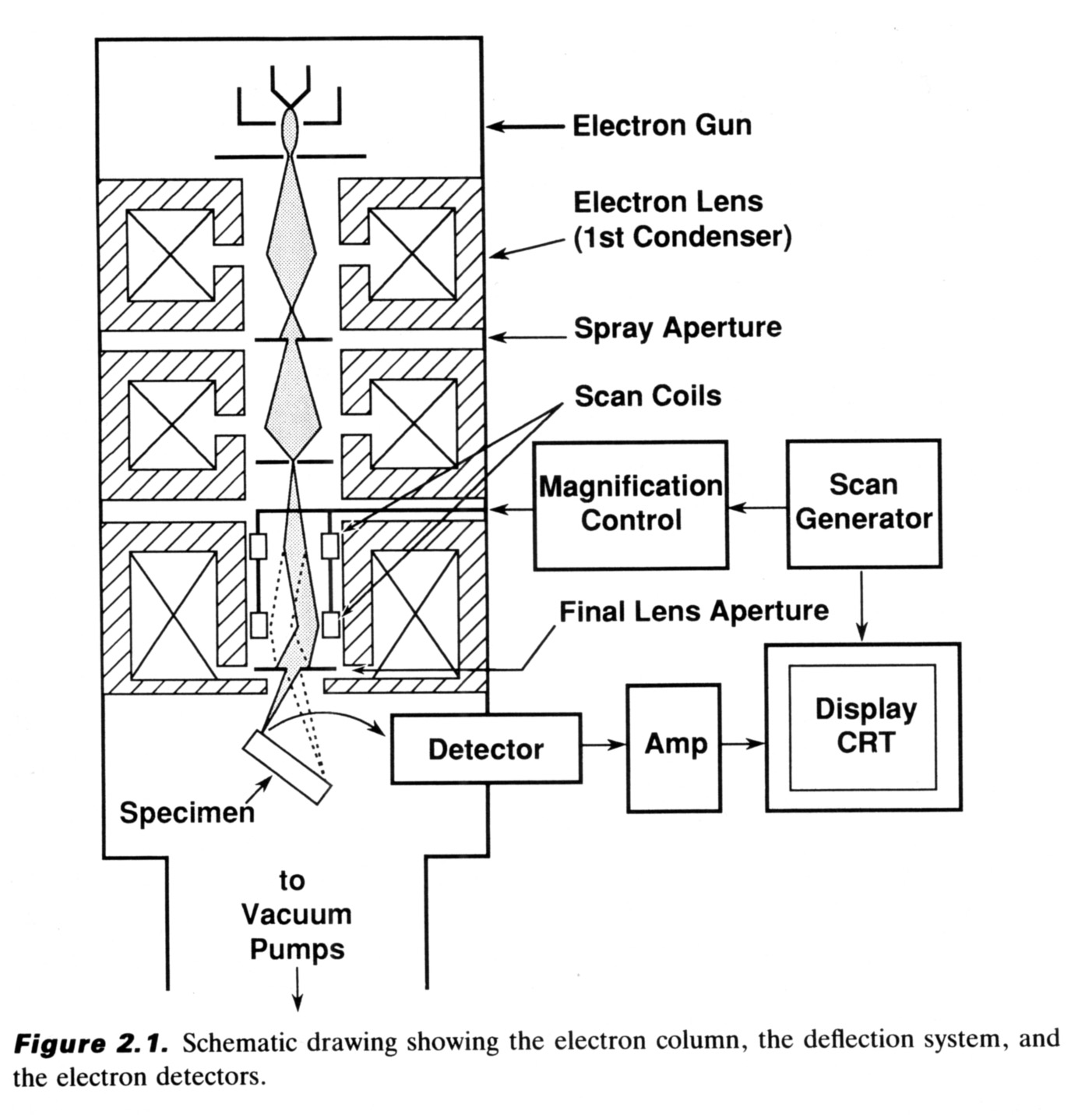
Parts of an SEM
• Vacuum chamber and pumps
Electron source
Electron column:
  High Voltage
  Condenser, Objective, and Stigmating optics
  Scan coils
Stage
Detectors
Analog or digital display

Slide 7
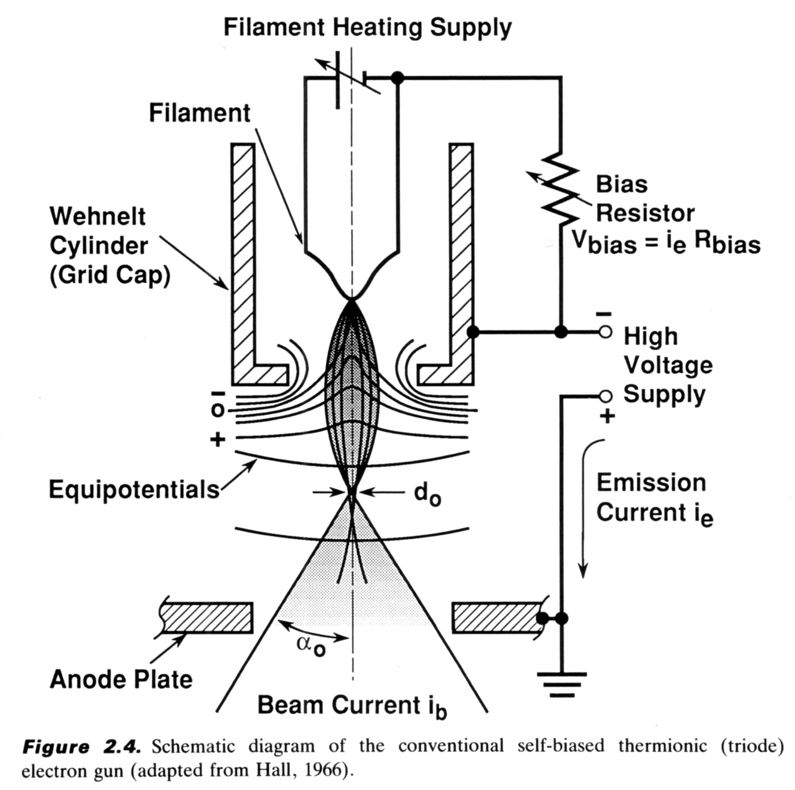
Electron sources: Filament

Slide 8
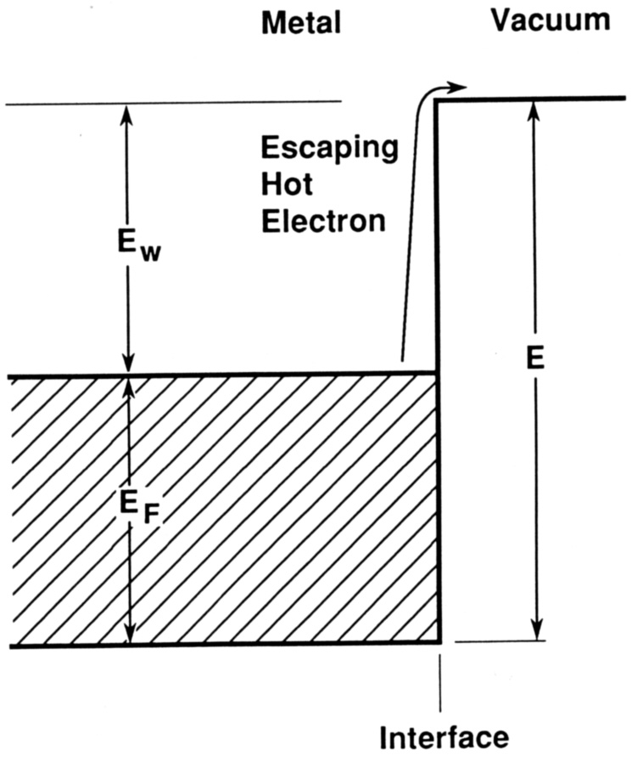
Electron sources: Filament
“Work function”
Fermi level
Ground state

Slide 9
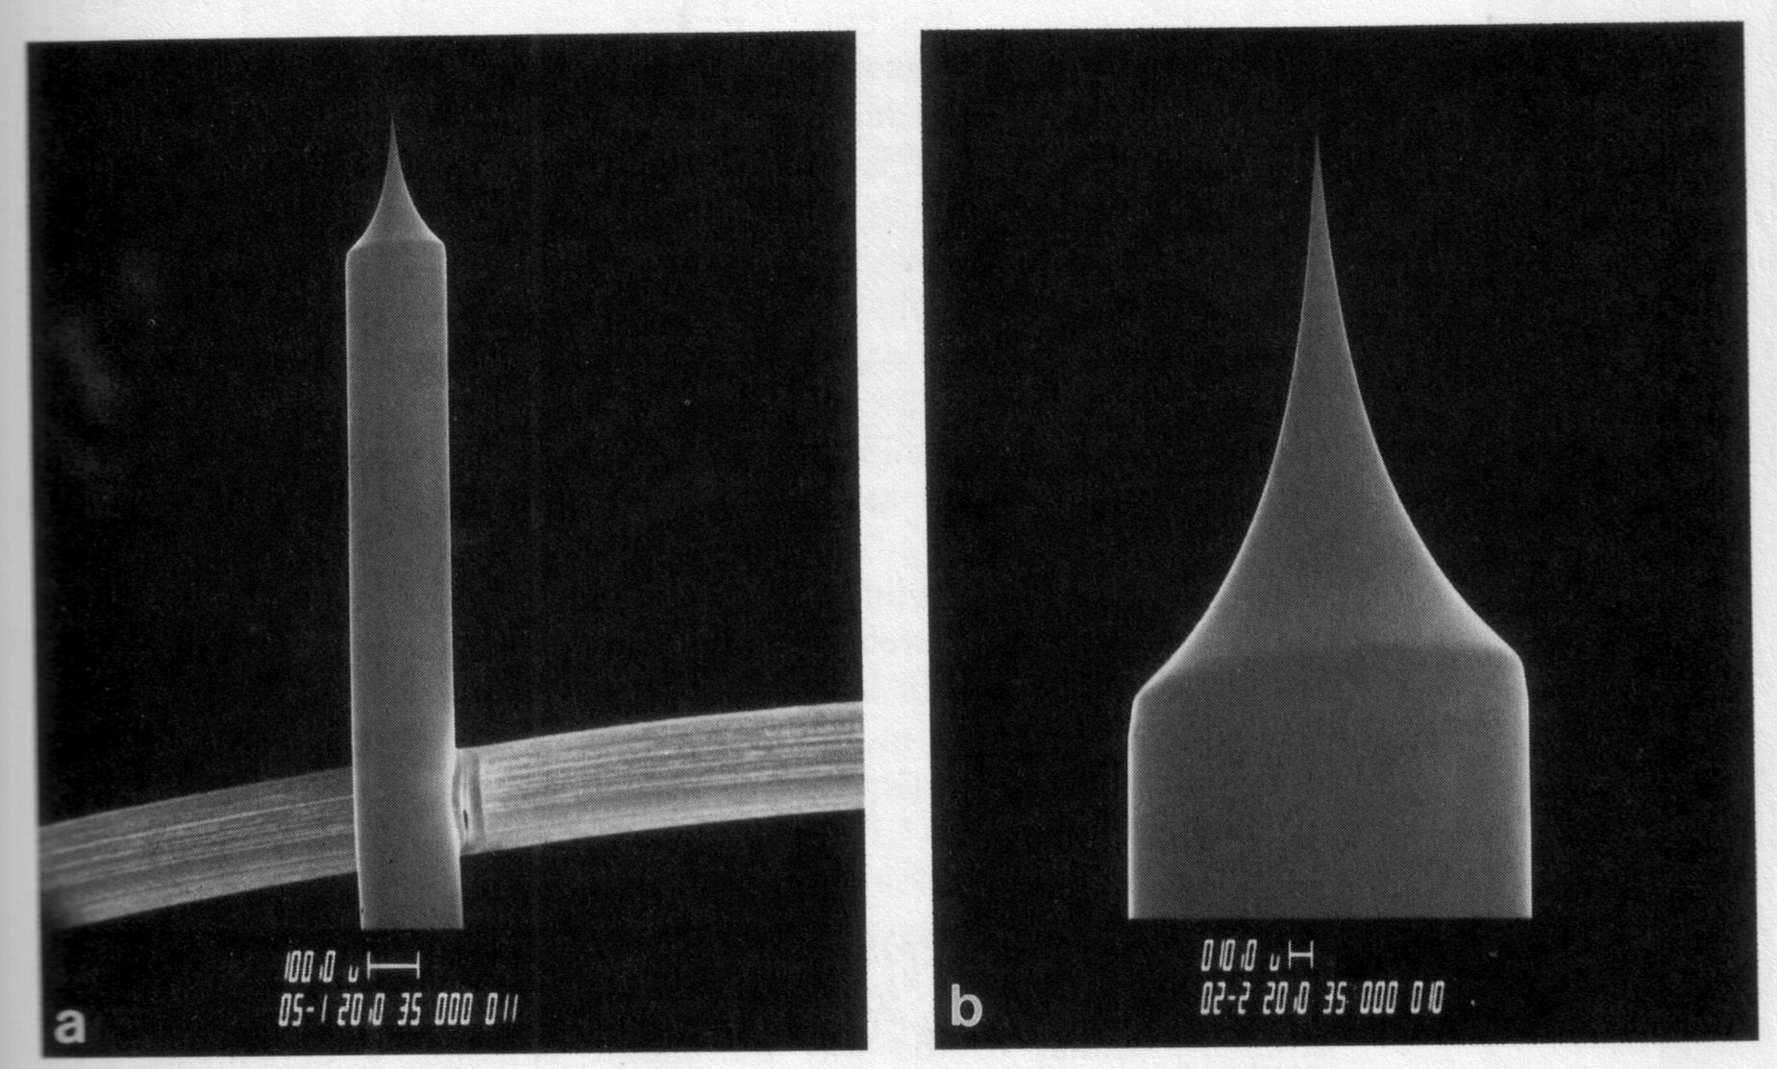
Electron sources: Field Emission

Slide 10
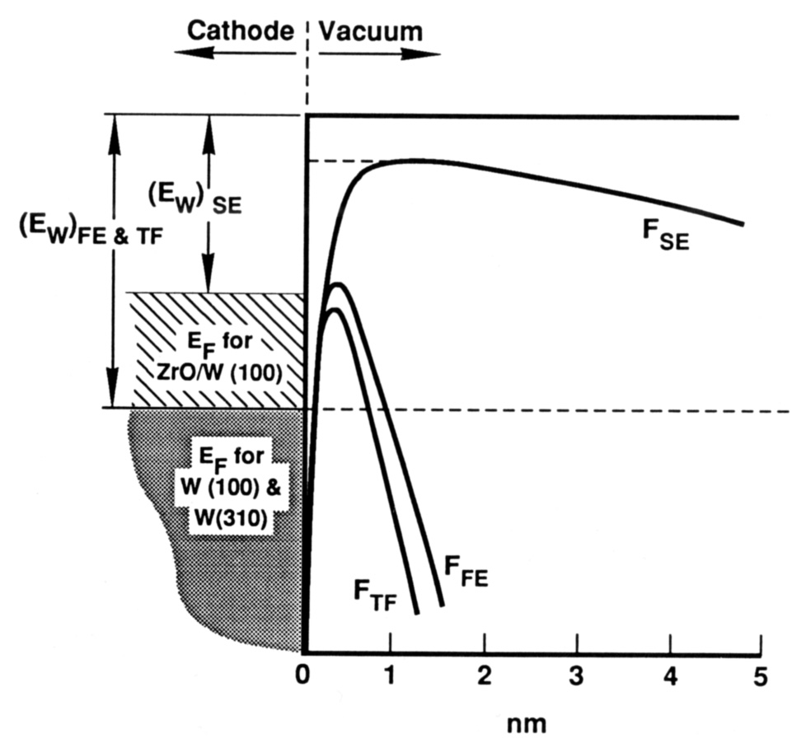
Electron sources: Field Emission

Slide 11
Electron sources: Comparison
Source | Brightness (A/cm²sr) | Lifetime | Source Size | Energy Spread | Beam Stability
W filament | 10⁵ | <100 h | >30 μm | 2.5 eV | 1%
LaB₆ | 10⁶ | <1000 h | >5 μm | 1.0 eV | 1%
Schottky Field Emission | 10⁸ | >1000 h | < 30 nm | 0.75 eV | 2% in 2005, 1% now
Cold Field Emission | 10¹⁰ | >3000 h | <1 nm | 0.35 eV | 2%
JEOL claims total currents up to 2 μA and 1%/hr stability for their new Schottky FE electron gun

Slide 12
Electron optics
Condenser Lenses
Apertures
  Together these determine beam current
Stigmators
  Determine beam shape
Scan Coils
  Determine magnification and scan rate
Objective Lens
  Determines working distance/focus

Slide 13
Electron Beam Limits
Understanding the trade-off between current and resolution
Probe current
Minimum beam diameter
~1
Source Brightness
Spherical Aberration Coefficient, ~2 cm
Electon DeBroglie wavelength, ~9 pm
Note, however, that beam diameter is not the same thing as imaging or analysis resolution…for many reasons.

Slide 14
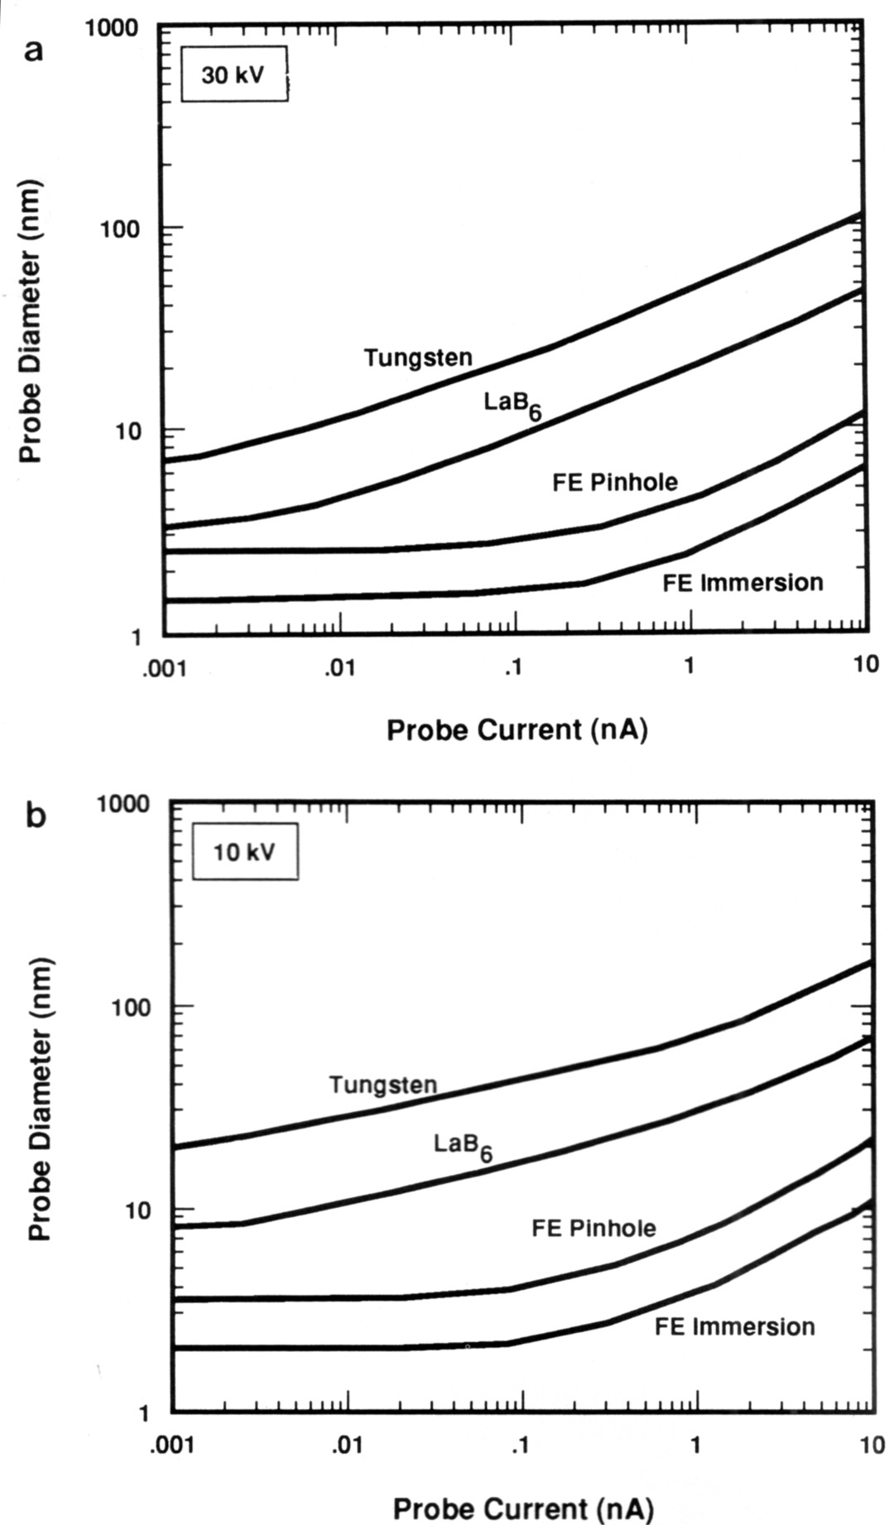
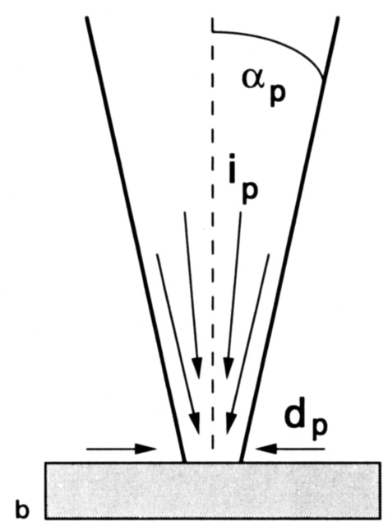
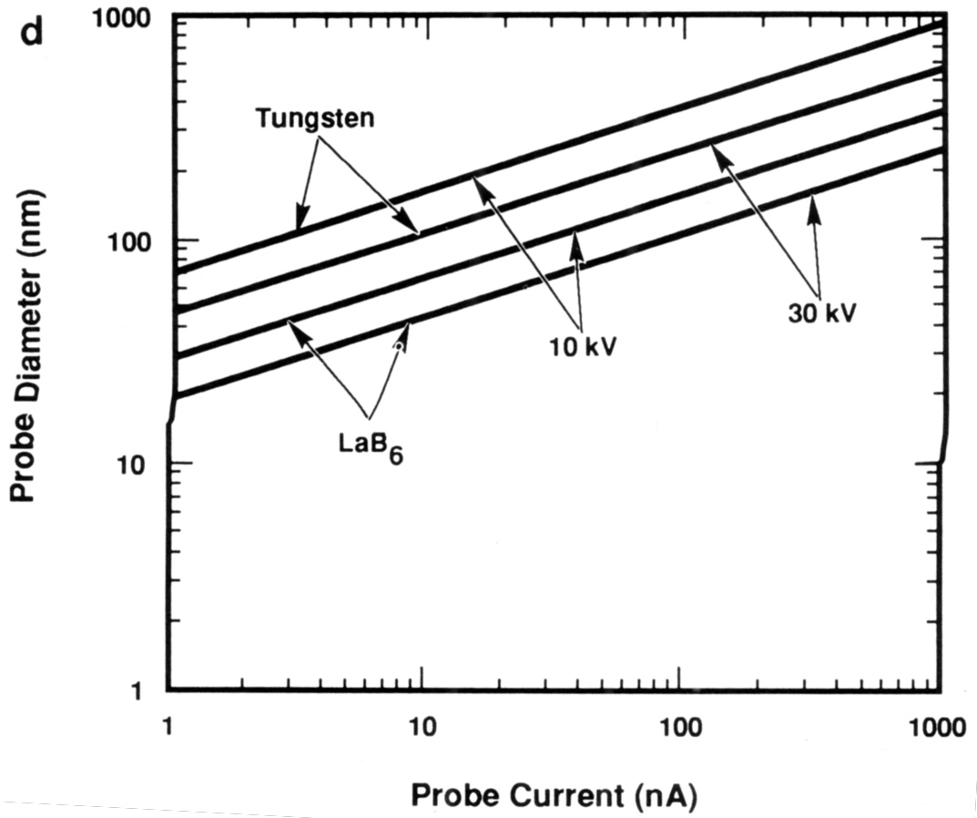
Electron Beam Limits

Slide 15
Beam-Specimen Interactions
Elastic
  Back-scattered electrons
Inelastic
  Secondary electrons
  Bremsstrahlung X-rays
  Characteristic X-rays
  Auger photoelectrons
Other
  Cathodoluminescence
  Specimen current

Slide 16
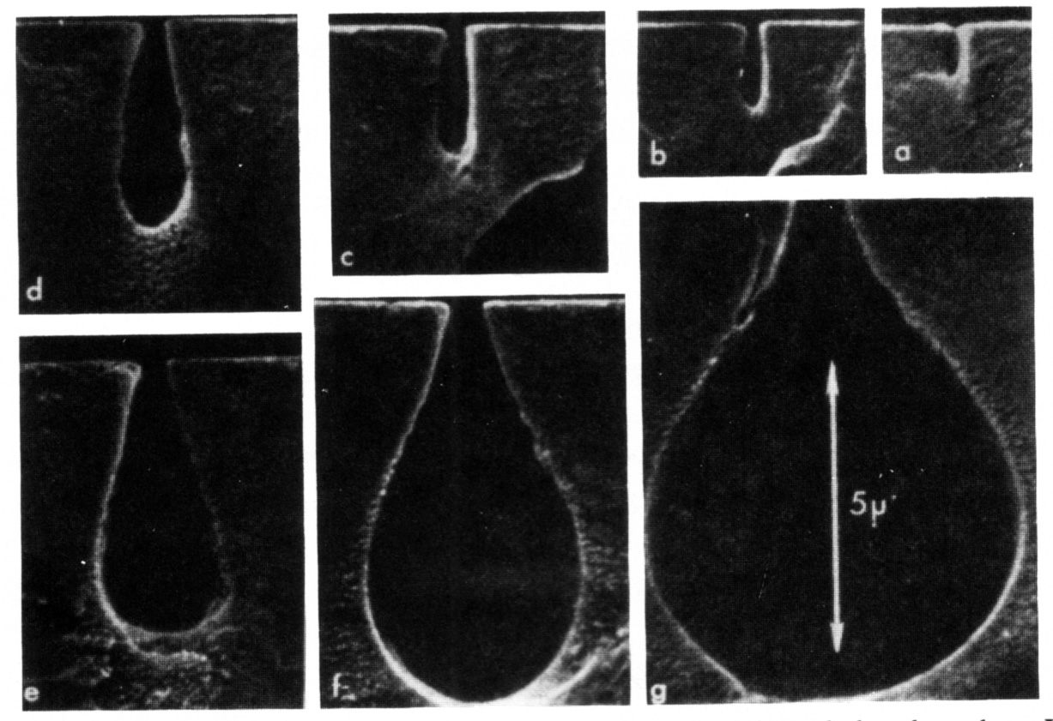
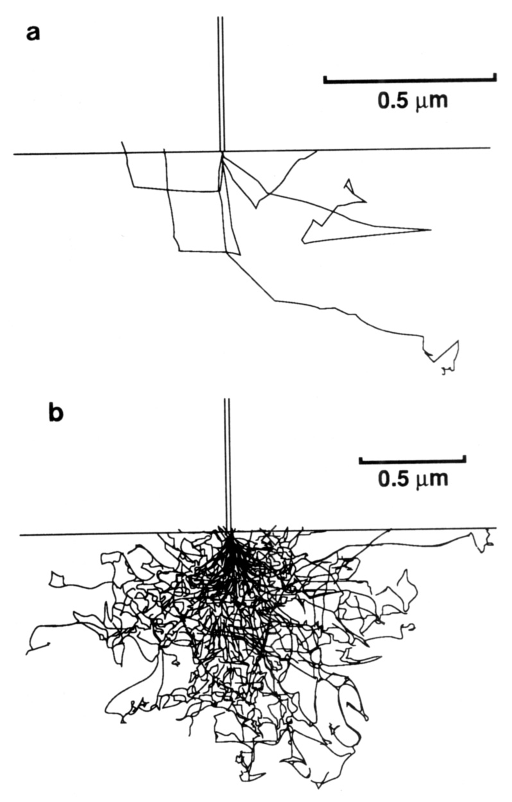
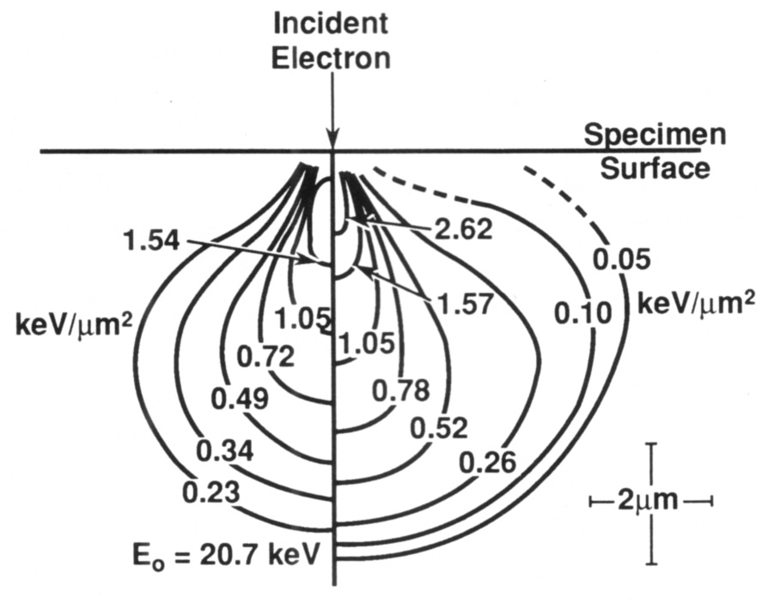
Beam-Specimen Interaction Volume

Slide 17
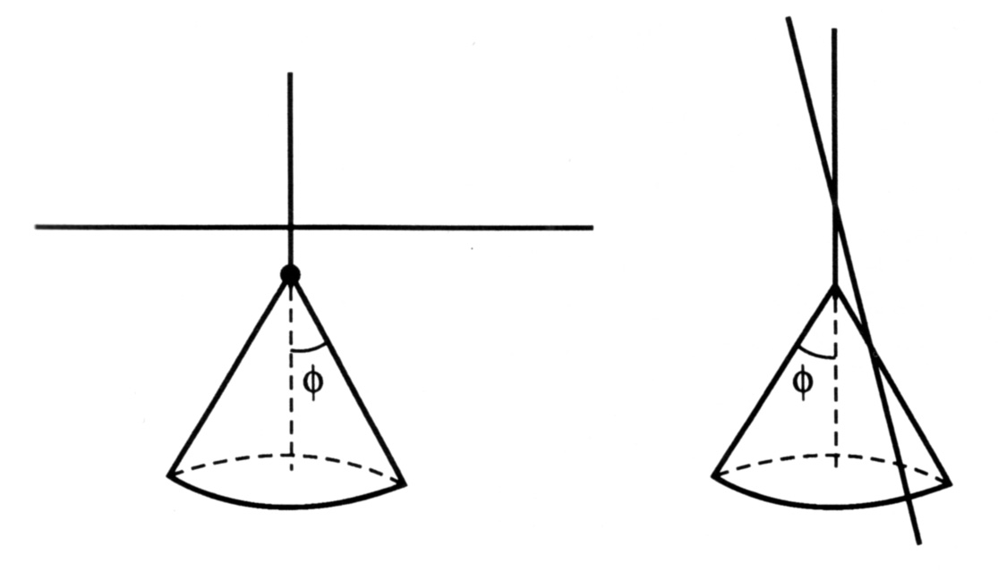
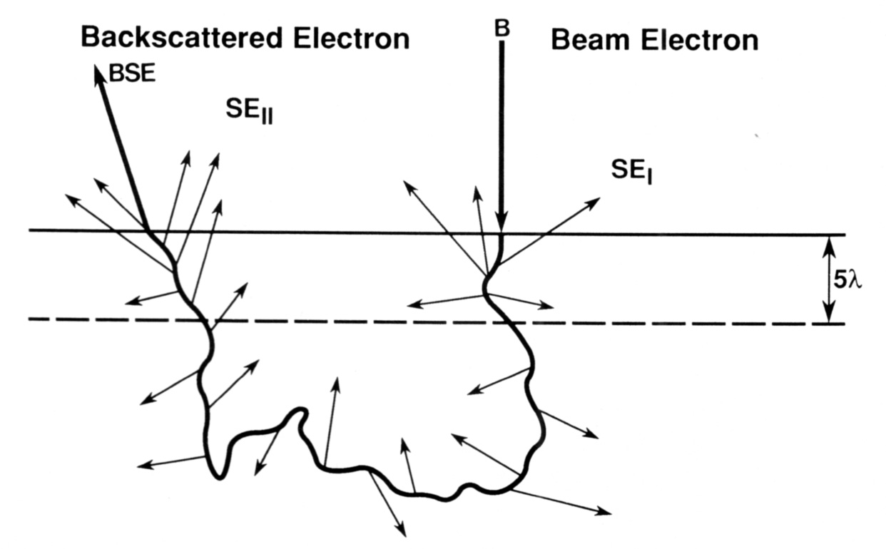
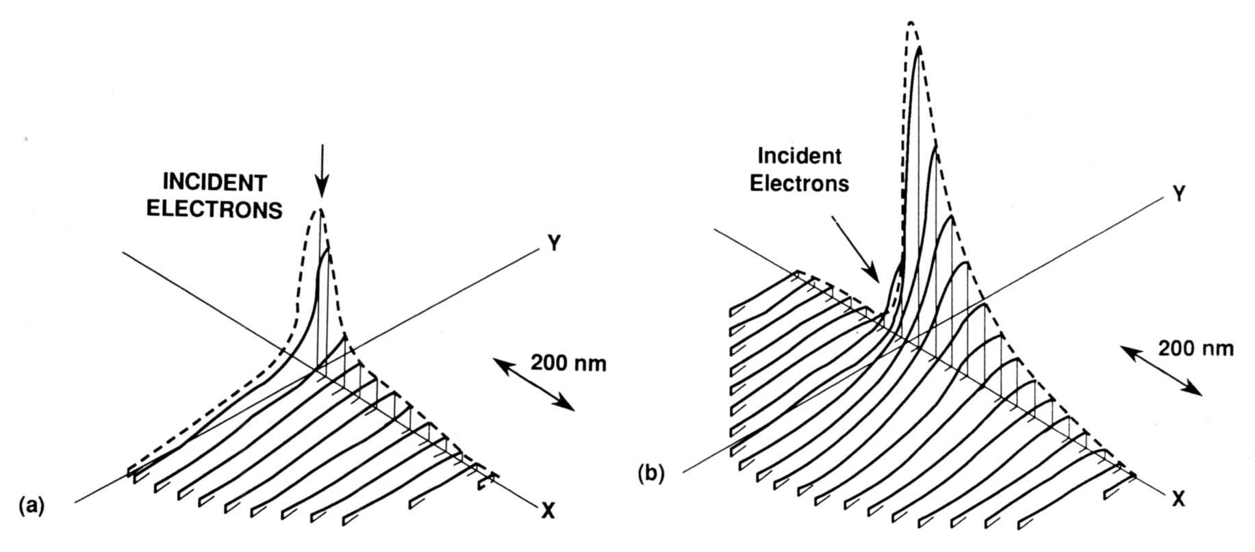
Beam-Specimen Interaction Volume
Increased backscatter yield for inclined specimen surface
Locations of secondary electron emission
Horizontal spread of backscatter emission for normal and inclined specimens

Slide 18
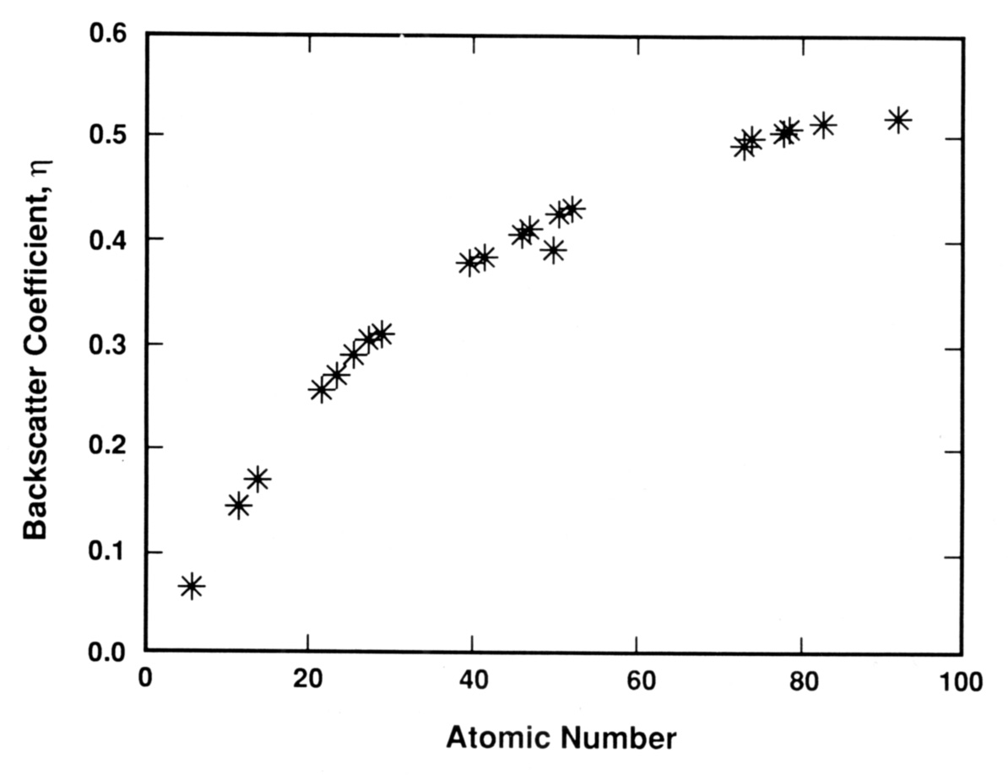
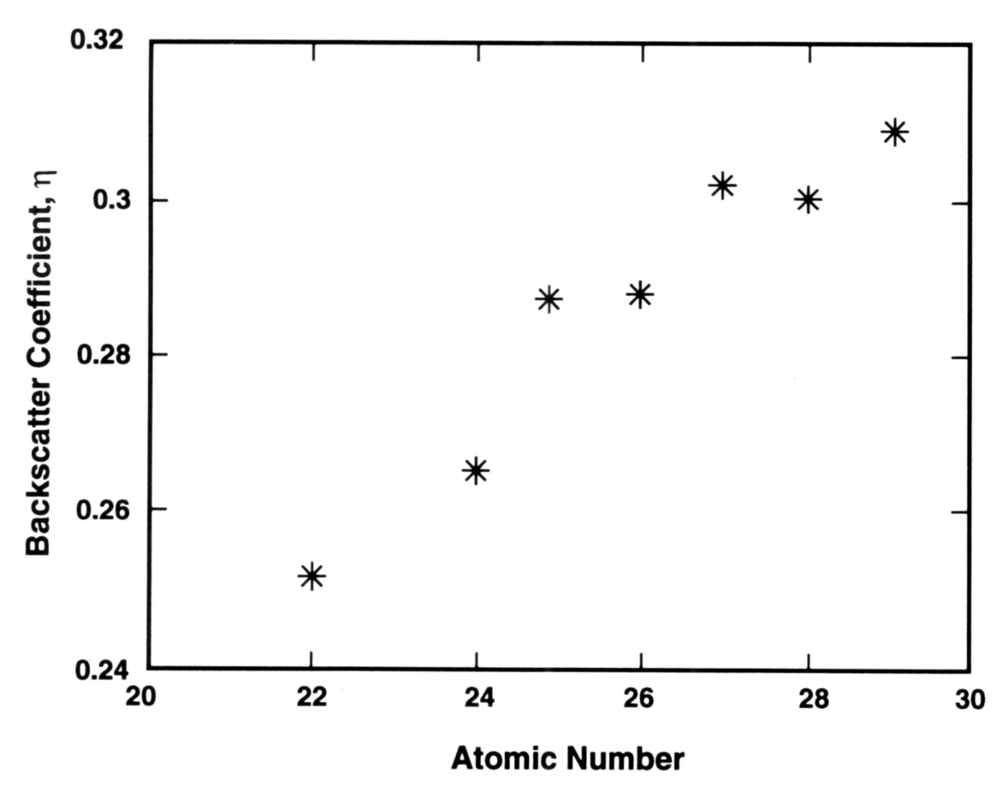
Backscattered Electrons

Slide 19
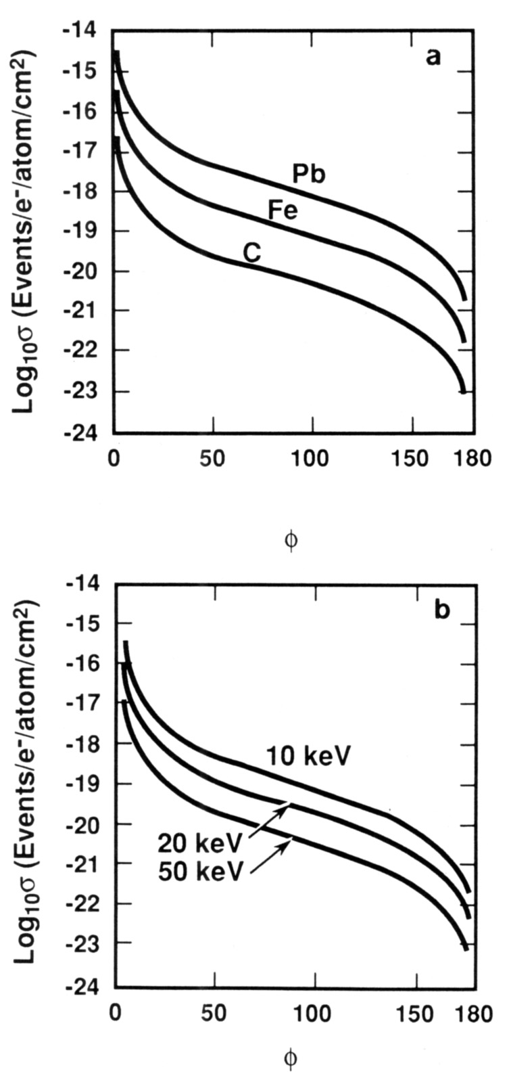
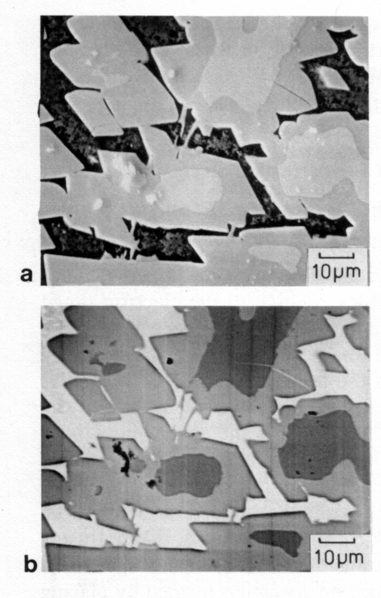
Backscattered Electrons
(b is specimen current image)

Slide 20
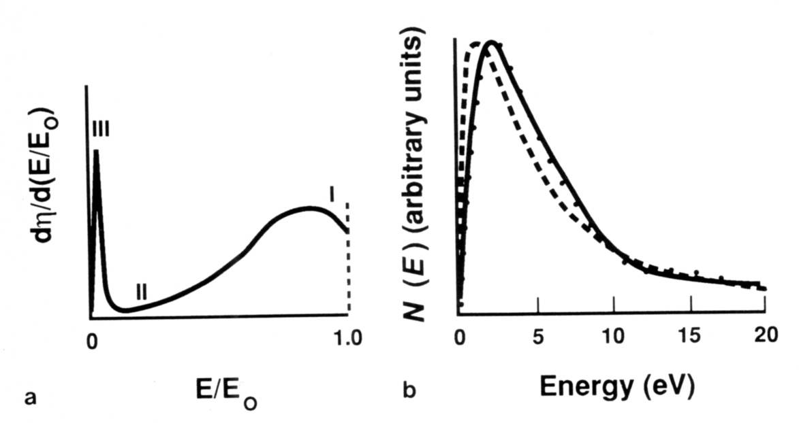
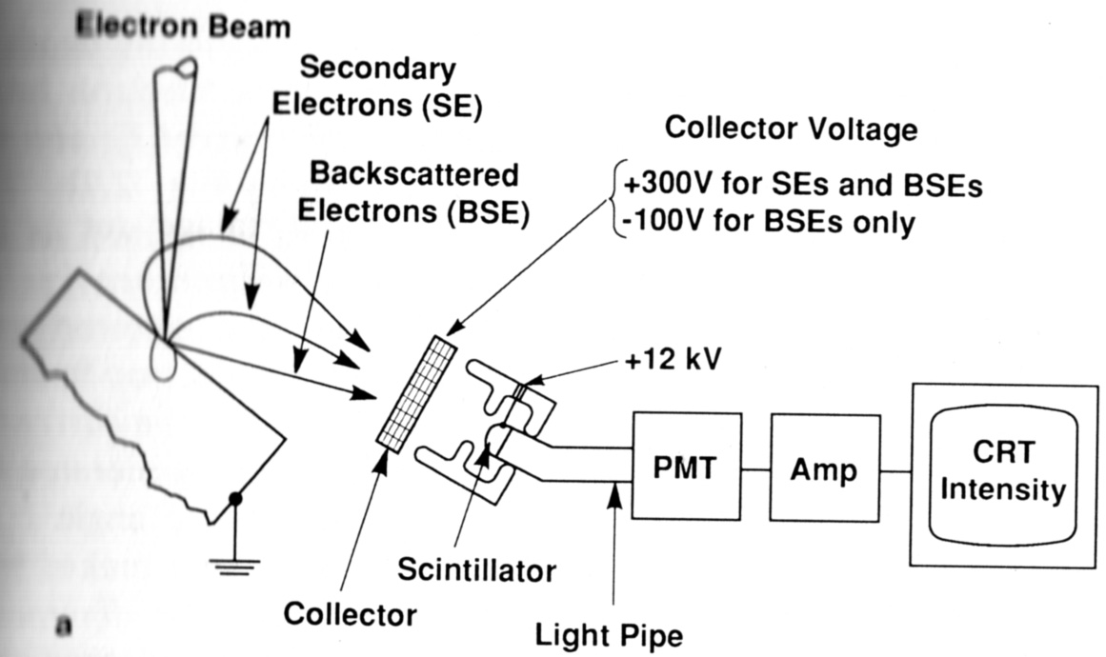
Secondary Electrons

Slide 21
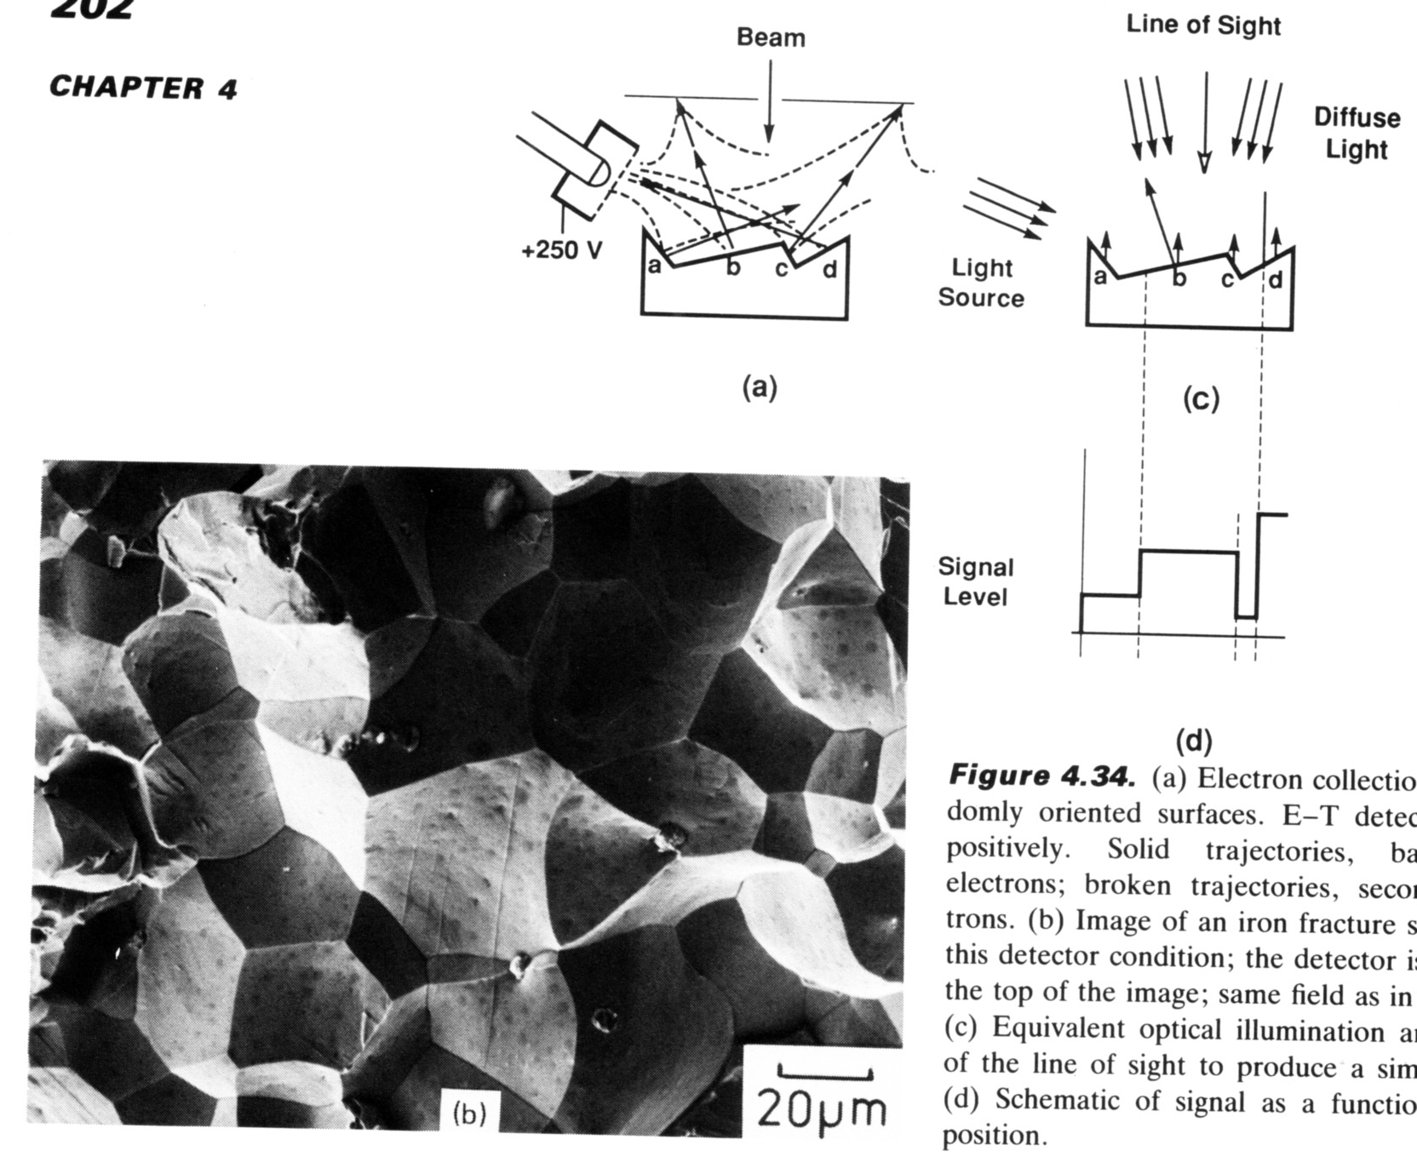
Secondary Electrons

Slide 22
Design of image acquisition
What spatial scale of feature(s) are you trying to see?
  Relative to excitation radius achievable with beam diameter, source, and instrument optics at a given current and voltage
  Always focus and stigmate as well as possible
What contrast mechanism will make feature(s) visible?
What scan rate will give sufficient signal to noise ratio?

